Slide 1
Learning

Slide 2
Different Perspectives
Behavioral psychologists have focused on the learning of associations through classical conditioning and operant conditioning
Cognitive psychologists studying learning are interested in the more complex type of learning involved in human memory

Slide 3
The Journey…
Learning Through Classical Conditioning
Learning Through Operant Conditioning
Biological and Cognitive Aspects
of Learning

Slide 4
Classical Conditioning
The process of learning in which one stimulus signals the arrival of another stimulus
Sometimes called “Pavlovian” conditioning because Ivan Pavlov was the first researcher to systematically study this type of learning

Slide 5
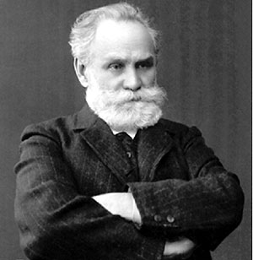
Ivan Pavlov (1849-1936)
Pavlov, a Russian physiologist, first described classical conditioning in 1899 while conducting research into the digestive system of dogs.
He was particularly interested in the role of salivary secretions in the digestion of food and was awarded the Nobel Prize for Medicine or Physiology in 1904.

Slide 6
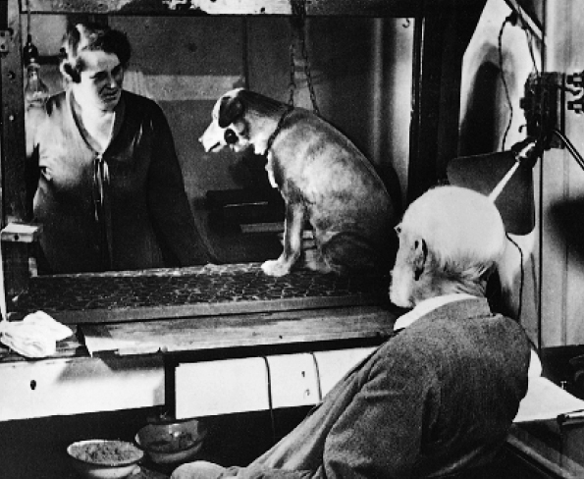
Pavlov
A Russian physiologist studying digestive
processes in dogs
The dogs were strapped into harnesses and had tubes inserted into their cheeks to measure the amount of salivation, the initial step in
the digestive process
With time, he noticed that
the dogs started to salivate
before the meat powder
was even put in their
mouths, and wanted to know
why this was happening

Slide 7
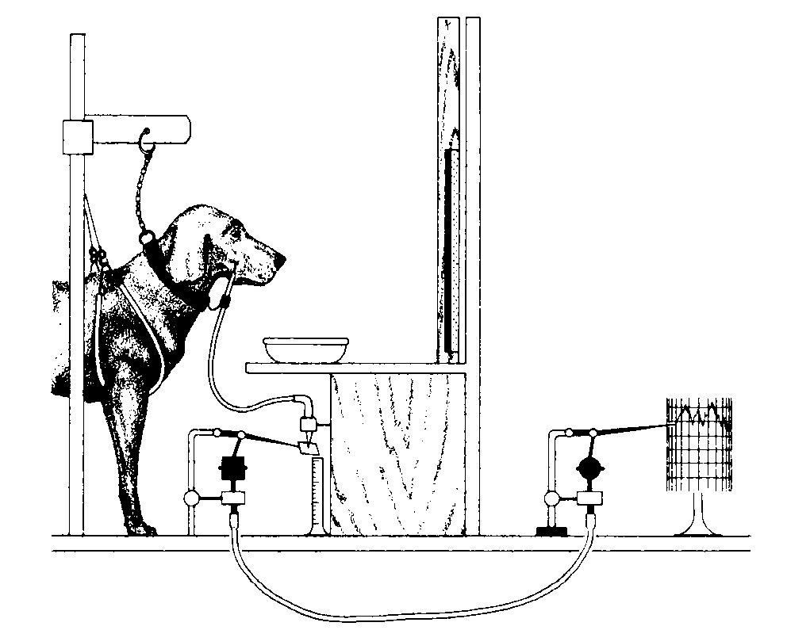
Pavlov’s Research
Pavlov used an apparatus to measure the amount of saliva produced when a dog ate.
The flow of saliva occurred naturally whenever food was placed in the dog’s mouth, as salivation is an involuntary, reflex response.

Slide 8
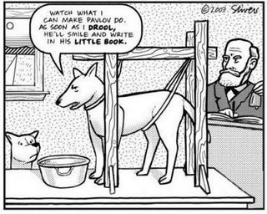
Pavlov’s Method
Dog was restrained in a harness to avoid extraneous variables.
Meat powder was placed directly on the dog’s tongue or in the bowl.
A tube was surgically attached to the dog’s cheek near one of the salivary glands and a fistula was made so that the saliva drained straight out into a measuring device.
Further on, more sophisticated measuring devices were used to measure the speed of saliva flow.

Slide 9
What did Pavlov observe?
Pavlov observed that the dogs salivated not only at the sight of the food, but also at the sight or sound of the lab tech who had been preparing the food.
Pavlov was intrigued by these unintentional observations & he decided to conduct further experiments.
His subsequent experiments provided clear evidence of a form of learning based on the repeated association of 2 different stimuli.
A stimulus is any event that elicits a response from an organism.
A response is a reaction by an organism to a stimulus. In Pavlov’s experiment, the stimulus of food initially produced the response of salivation.
Eventually the sight or sound of the tech became the stimulus.

Slide 10


How is this response explained?
The salivation response is controlled by the autonomic division of the PNS.
Involuntary.
The salivation had become associated with, and conditioned to, a new stimulus – the lab tech.
This process is in essence the process of classical conditioning.

Slide 11
What is Classical Conditioning?
Also known as respondent conditioning refers to a form of learning that occurs through the repeated association of 2 or more different stimuli.
Learning is only said to have occurred when a particular stimulus consistently produces a response that it did not previously produce.
In classical condition, a response that is automatically produced by one stimulus becomes associated, or linked, with another stimulus that would not normally produce this response.

Slide 12
Elements and Procedures of Classical Conditioning
Unconditioned Stimulus (UCS)
Unconditioned Response (UCR)
Associated
Similar
Conditioned Stimulus
(CS)
Conditioned Response
(CR)

Slide 13

1. Unconditioned Stimulus
The unconditioned stimulus (UCS) is any stimulus that consistently produces a particular, naturally occurring, automatic response.
In Pavlov’s experiment, the UCS was the food (meat powder).

Slide 14
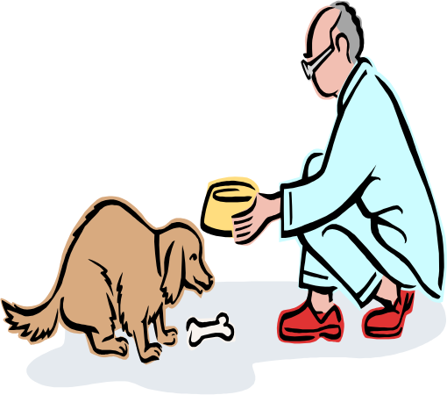
2. Unconditioned Response
The unconditioned response (UCR) is the response that occurs automatically when the UCS is presented.
A UCR is a reflexive, involuntary response that is predictably caused by a UCS.
In Pavlov’s experiments, the UCR was the salivation.

Slide 15
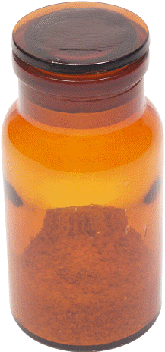
UCS and UCR
Dogs salivate when meat powder is put in their mouths – this is a reflex, a response that occur automatically in
the presence of a certain stimulus
(i.e., meat powder)
An unconditioned stimulus (UCS)
is the stimulus that elicits the reflexive response (here, the UCS is the meat powder)
An unconditioned response (UCR)
is the response automatically elicited
by the UCS (here, the UCR is salivating in response to the meat powder)

Slide 16
Elements and Procedures of Classical Conditioning
Unconditioned Stimulus (UCS)
Unconditioned Response (UCR)
Associated
Similar
Conditioned Stimulus
(CS)
Conditioned Response
(CR)

Slide 17
3. Conditioned Stimulus
The conditioned stimulus (CS) is the stimulus that is neutral at the start of the conditioning process and does not normally produce the UCR.
Yet, through repeated association with the UCS, the CS triggers a very similar response to that caused by the UCS.
Association refers to the pairing or linking of 1 stimulus with another stimulus.
In Pavlov’s experiments, the bell and subsequently other stimuli were initially neutral, but each became associated with the meat powder.
Once conditioning has occurred and the originally neutral stimulus produces the response of salivating, then it is called the CS.

Slide 18
4. Conditioned Response
The conditioned response (CR) is the learned response that is produced by the CS.
The CR occurs after the CS has been associated with the UCS.
The behaviour involved in a CR is very similar to that of the UCR, but it is triggered by the CS alone.
Pavlov’s dogs displayed a CR (salivation) only when they began to salivate to a CS.
When the dog responded to a CS, such as the sound of a bell, classical conditioning had taken place because salivation would not be a usual response to the sound of a bell.

Slide 19
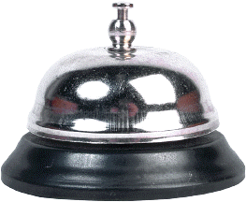
CS and CR
A neutral stimulus is a stimulus that does not naturally elicit the to-be-conditioned response (e.g., auditory tones)
To achieve conditioning, the neutral stimulus (a tone) is presented just before (ideally one-half to one full second before) the UCS (meat powder) for several trials
Once the conditioning occurs (that is, the dog
starts to salivate to the sound of the tone
before the food is put in its mouth), the
neutral stimulus is called the
conditioned stimulus (CS)
The learned response to the
conditioned stimulus is called the
conditioned response (CR)

Slide 20
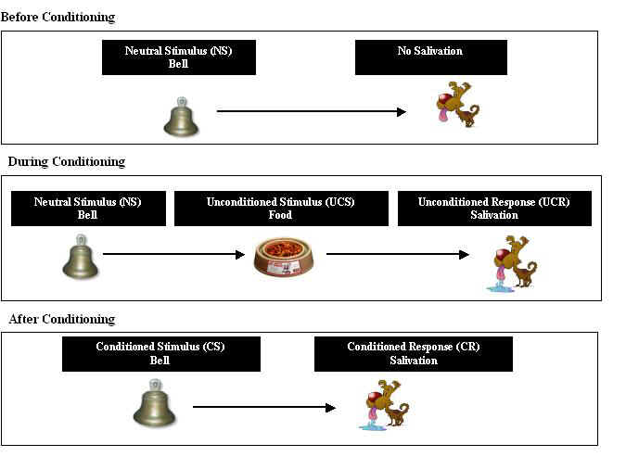

Slide 21
The “Little Albert” Study
John Watson and Rosalie Rayner conducted a study on an 11-month-old infant named Albert
While Albert was looking at a little white rat, Watson quietly sneaked behind him with a long iron bar and a hammer and clanged the two together
Albert’s reflexive response, the UCR, was a fear-avoidance response (e.g., crying and trying to crawl away) to the loud noise, which was the UCS
After pairing the white rat with the unexpected loud noise only 7 times, the white rat became a CS

Slide 22
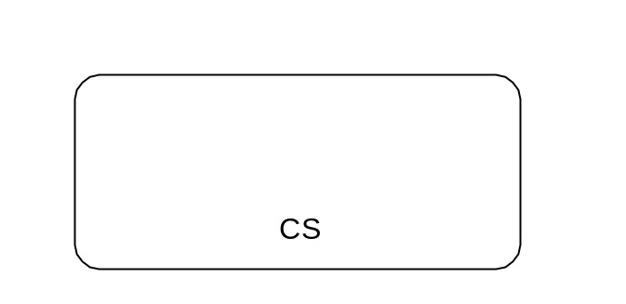

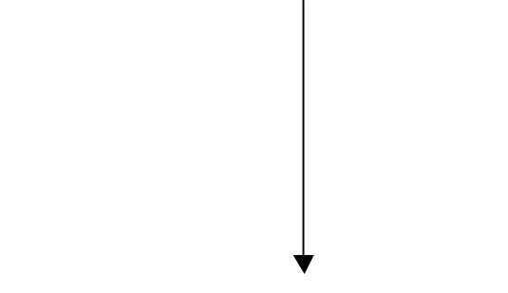
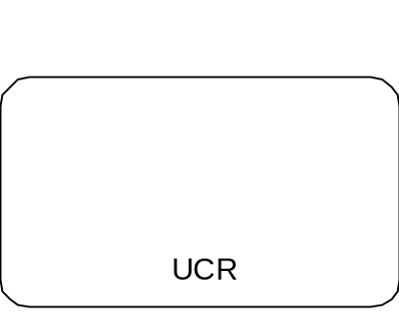
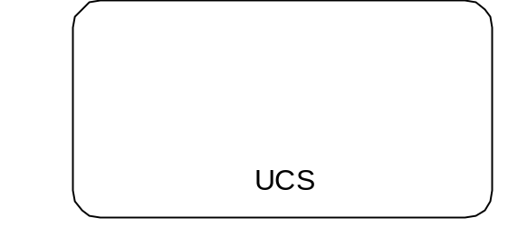
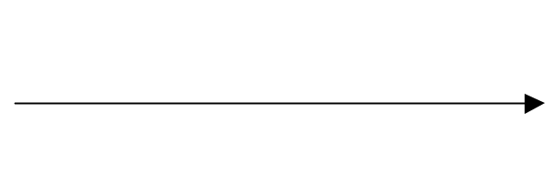


During Conditioning (Association & Acquisition)
Is associated with
Which automatically leads to the

Slide 23
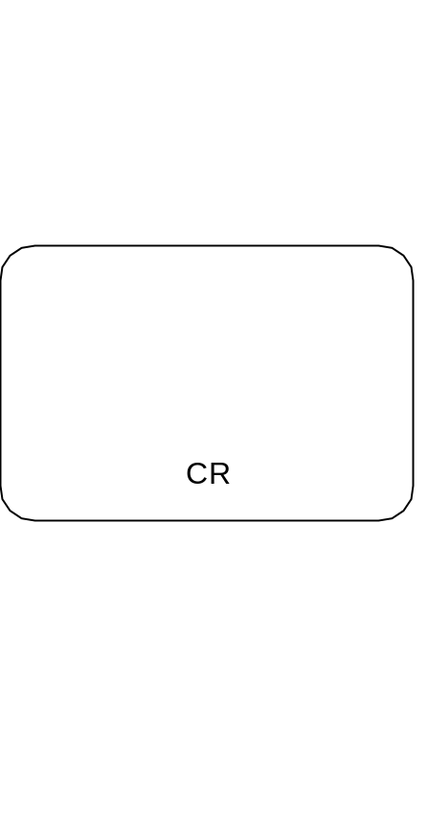
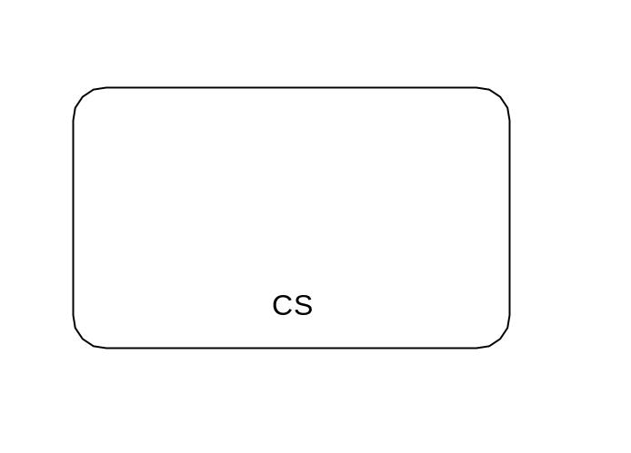
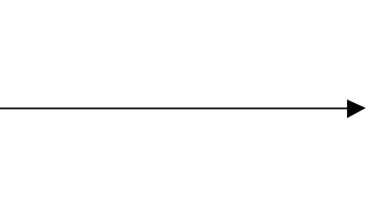
After Conditioning
Leads to a conditioned response

Slide 24
Ethical considerations?
Albert’s mother left her job and Watson and Rayner reported that they were denied the opportunity to remove the conditioned emotional responses.
This has been disputed, as it is believed they were aware of Albert’s departure a month in advance.
Some believe Albert’s mother may not have been fully aware of the experimental condition and effect on her son.
Informed consent is not mentioned in Watson original article, so a judgement cannot be made about this ethical issue.
Also possible that Albert was vulnerable to psychological harm as a result of the experiments.
Yet Albert was subjected to severe anxiety and distress & the experimenters made not attempt to end the experiment and attend to his distress in an appropriate way.

Slide 25
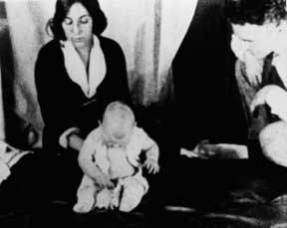
Albert after the experiments?
Some psychologists have suggested that Albert’s conditioned fears might have disappeared over time, however it is reasonable to assume that Albert was not only emotionally traumatised by the experimental procedures to which he was subjected, but was also likely to have suffered some kind of lasting psychological harm.
Experiments using any human participant in this way would be considered unethical today and would not be permitted.

Slide 26
Other Evidence
Elise Bregman was unable to condition infants to fear inanimate objects such as wooden blocks and cloth curtains, suggesting possible biological predispositions to learn certain fears easier than others
Classical conditioning can be used to condition positive reactions, such as in advertising to condition positive attitudes and feelings toward certain products (e.g., a celebrity serves as a UCS, and the product as the CS)

Slide 27
Classical Conditioning in Practice
CC is used in a range of different settings, many of which are concerned with therapeutic benefits. These include:
Aversion therapy and systematic desensitisation.

Slide 28
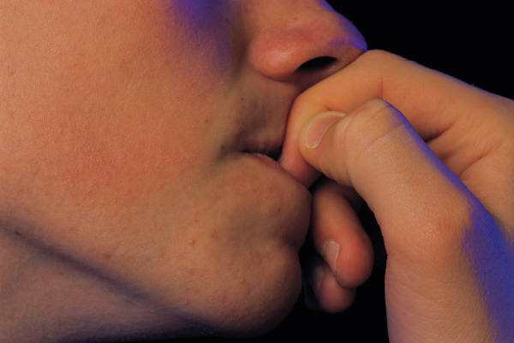
Aversion Therapy
When people develop behaviours that are habitual and harmful to themselves or to others, such as substance dependence, it is difficult to help them permanently stop the unwanted behaviour.
Aversion therapy is a form of behaviour therapy that applies CC principles to inhibit or discourage undesirable behaviour by associating it with an aversive stimulus.
The aim of aversion therapy is to suppress or weaken undesirable behaviour.
E.g. to stop unwanted behaviour such as nail biting, we might paint our nails with a foul-tasting substance.
The association between nail biting and the unpleasant taste is learned quickly.

Slide 29
General Learning Processes in Classical Conditioning
Acquisition is the process of acquiring a new response, that is, a CR to a CS
  The strength of the CR increases during acquisition
Other processes:
Extinction
Stimulus
Generalization
Spontaneous
Recovery
Stimulus
Discrimination

Slide 30
Extinction
A CS must reliably signal that the UCS is coming
Extinction is the disappearance of the CR when the UCS no longer follows the CS
  The strength of the CR decreases during extinction

Slide 31
Spontaneous Recovery
During the extinction process, however, the CR mysteriously increases somewhat in strength following a rest interval
This is called spontaneous recovery
  As extinction continues, the recovery observed following rest intervals continues to decrease until it is minimized

Slide 32
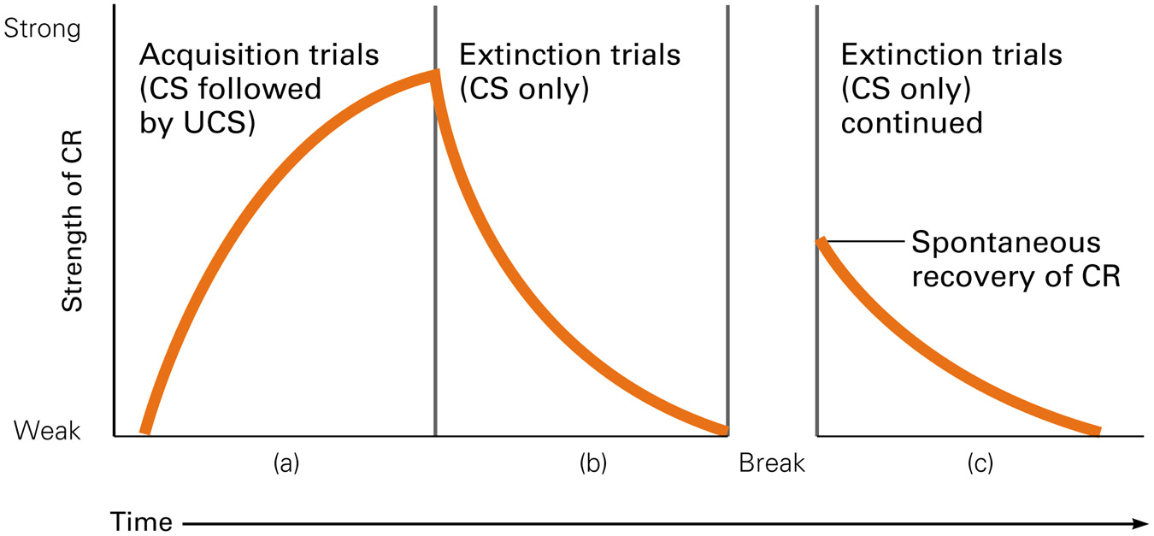
Acquisition, Extinction, and Spontaneous Recovery

Slide 33
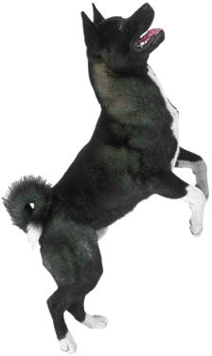
Stimulus Generalization
Stimulus generalization is giving the CR to a stimulus similar to the CS
  The more similar the stimulus is to the CS, the stronger the response will be
  For example, if a dog learns to bark at the door bell, she may, at least in a new home, also bark at the telephone because both stimuli are ringing noises
  This is an adaptive process because classical conditioning would not be very useful if it only allowed us to learn relationships between specific stimuli

Slide 34

Stimulus Discrimination
Overgeneralizing a response may not be adaptive, however; thus, we need to learn to discriminate among stimuli
Stimulus discrimination
is learning to give the CR only to the CS or only to a small set of very similar stimuli
including the CS
  For example, after being in her
  new home for a period of time,
  the dog will learn to
  differentiate/discriminate
  between the door bell and the
  phone ringing noises

Slide 35
Discrimination Training
During discrimination training, you present many different stimuli numerous times, but the UCS only follows one CS
  This procedure will extinguish the responses to other stimuli

